Slide 1
CROSS-AD: Two-Channel EEG-MRI Learning for Explainable Alzheimer’s Disease Prediction
CS 506 Final Project October Check-In
Aoming Liu, PhD Candidate in Computer Science
Runkun Guo, PhD Candidate in Bioinformatics

Slide 2
Why Early Prediction of Alzheimer’s Disease Matters
CROSS-AD
Why Early Prediction of Alzheimer’s Disease Matters
Alzheimer’s disease is a progressive neurodegenerative disorder.
Structural, functional and molecular abnormalities can occur before severe cognitive symptoms.
Early prediction may support:
  earlier intervention
  improved patient stratification
  monitoring of disease progression
Current molecular biomarkers remain incomplete when used independently (Preciously on CROSS_CIRC Guo et al., ICLR 2027).
→ Can we jointly model brain structural degeneration and functional dysfunction for improved AD prediction?

Slide 3
Two Views of AD
CROSS-AD
MRI → Structural degeneration
  Measures brain shape: the hippocampus shrinks and the ventricles grow in Alzheimer’s disease (AD)
EEG → Functional dysfunction
  Measures brain activity: rhythms slow down, with more theta and less alpha power
Goal: Predict AD vs cognitively normal (CN) from each channel, then test whether combining them helps, but only on people who have both scans.

Slide 4
Where are we now?
CROSS-AD
Stage | Status | What we did
Data collection | Done | ADNI MRI regional measures, Synapse BrainLat EEG (8 GB) and OpenNeuro ds004504 resting-state EEG (2.2 GB) on the SCC
Data cleaning | Done | QC, one scan per person, 3T, age/sex matching, EEG file audit
Feature extraction | Done | 321 MRI regional measures; 26 EEG spectral features
Visualization | Done | Data report with 8 figures; results report
Model training (fundemental) | Done | Baselines plus a first joint EEG–MRI model with ablations
Paired fusion | Waiting | Needs BrainLat MRI download access

Slide 5
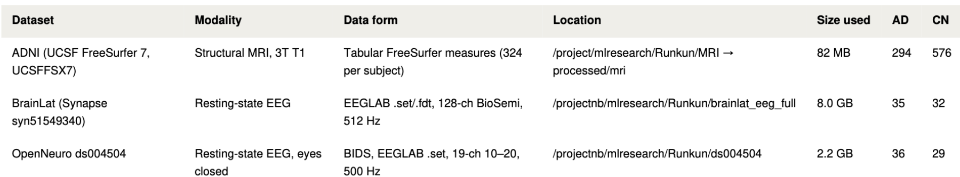
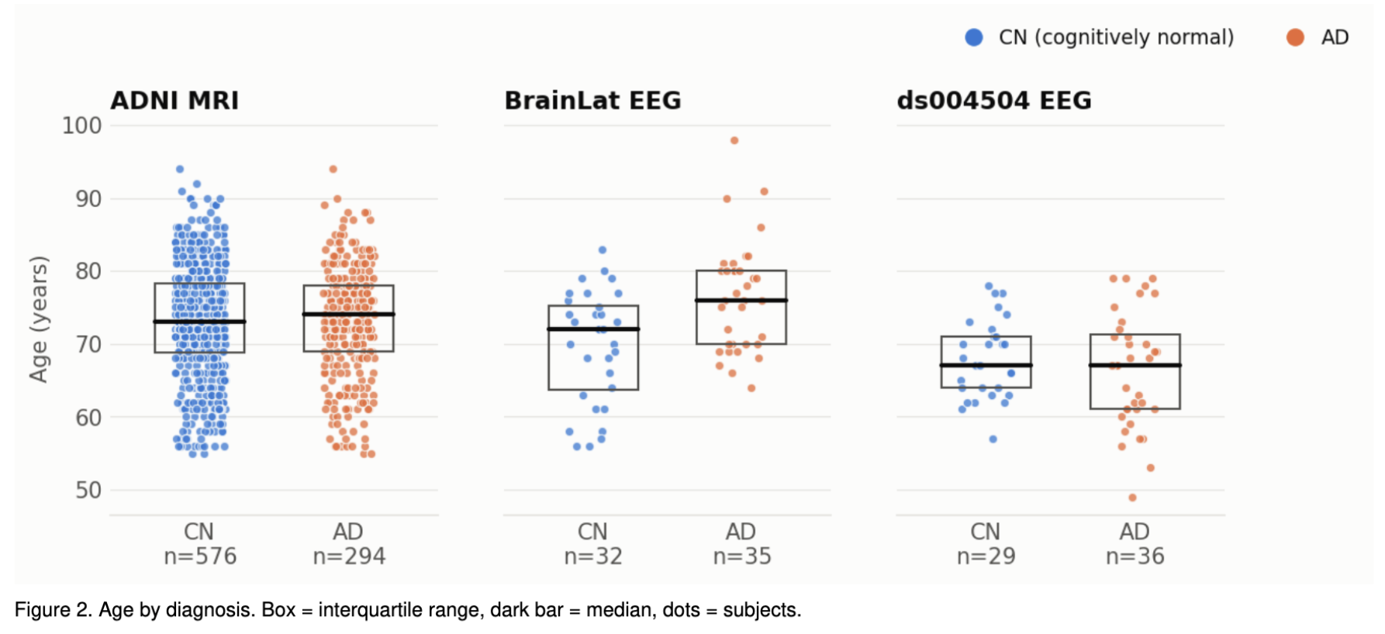
Data Overview
CROSS-AD

Slide 6
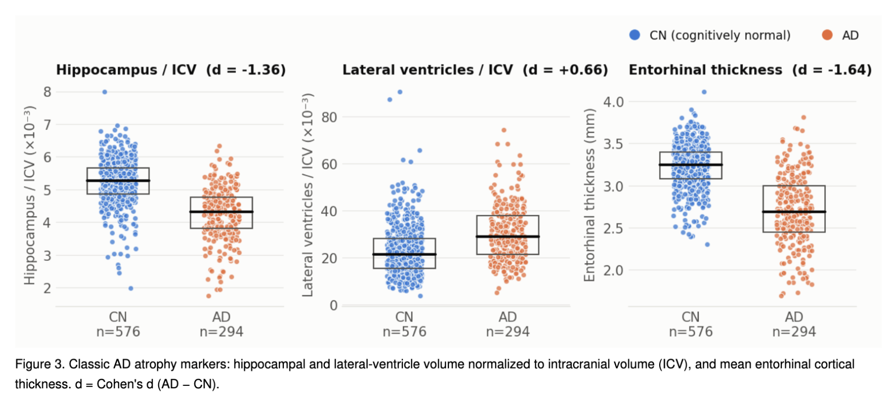
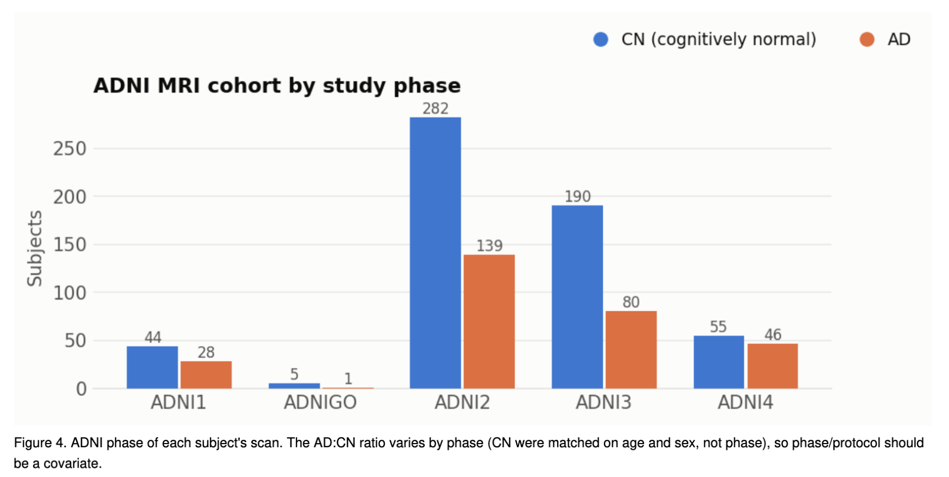
MRI: ADNI Structural Measures
CROSS-AD
•Dropped failed quality checks; blanked brain regions that failed region-level QC
•One scan per person, so no one appears in both training and test data
•Diagnosis from the clinic visit closest to the scan (median gap: 10 days)
Notes:
MRI shows the classic AD atrophy pattern

Slide 7
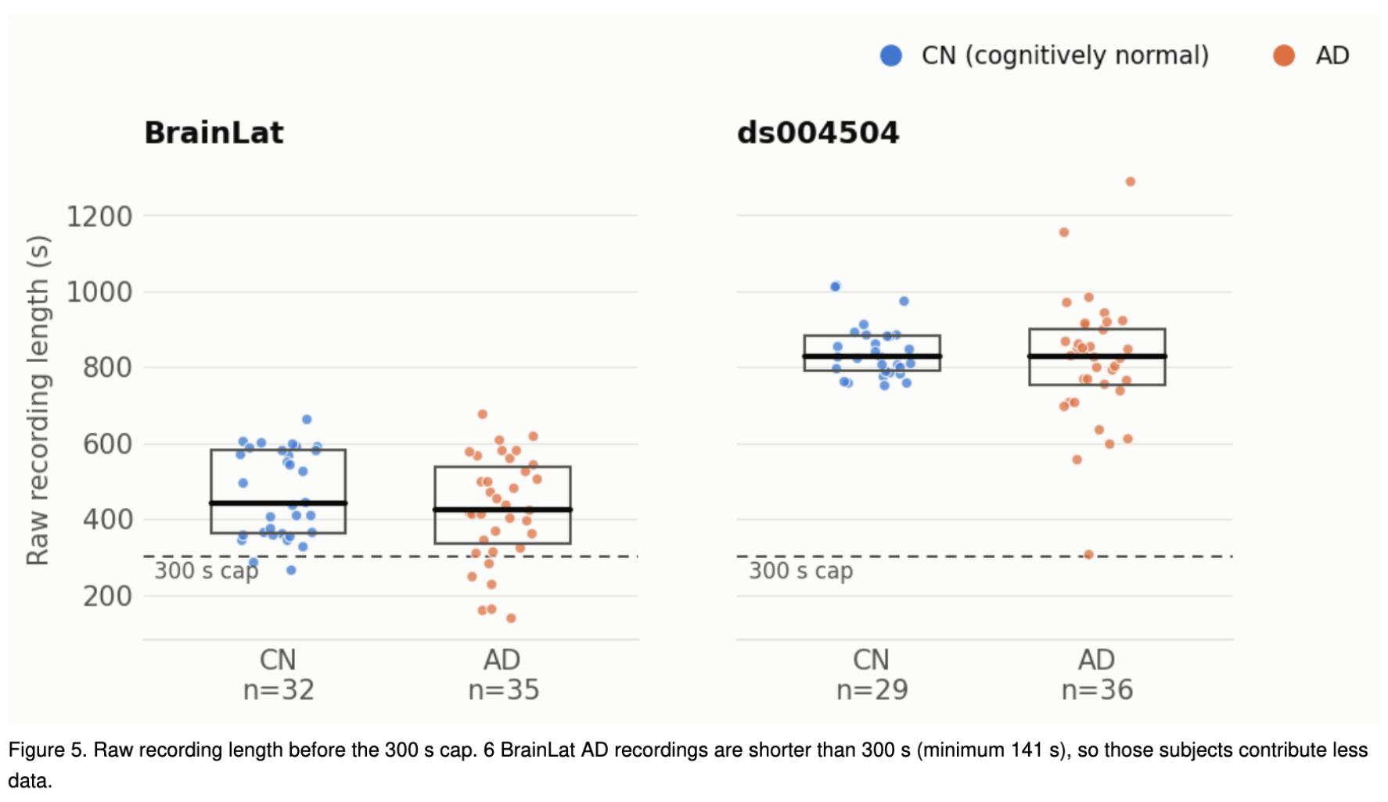
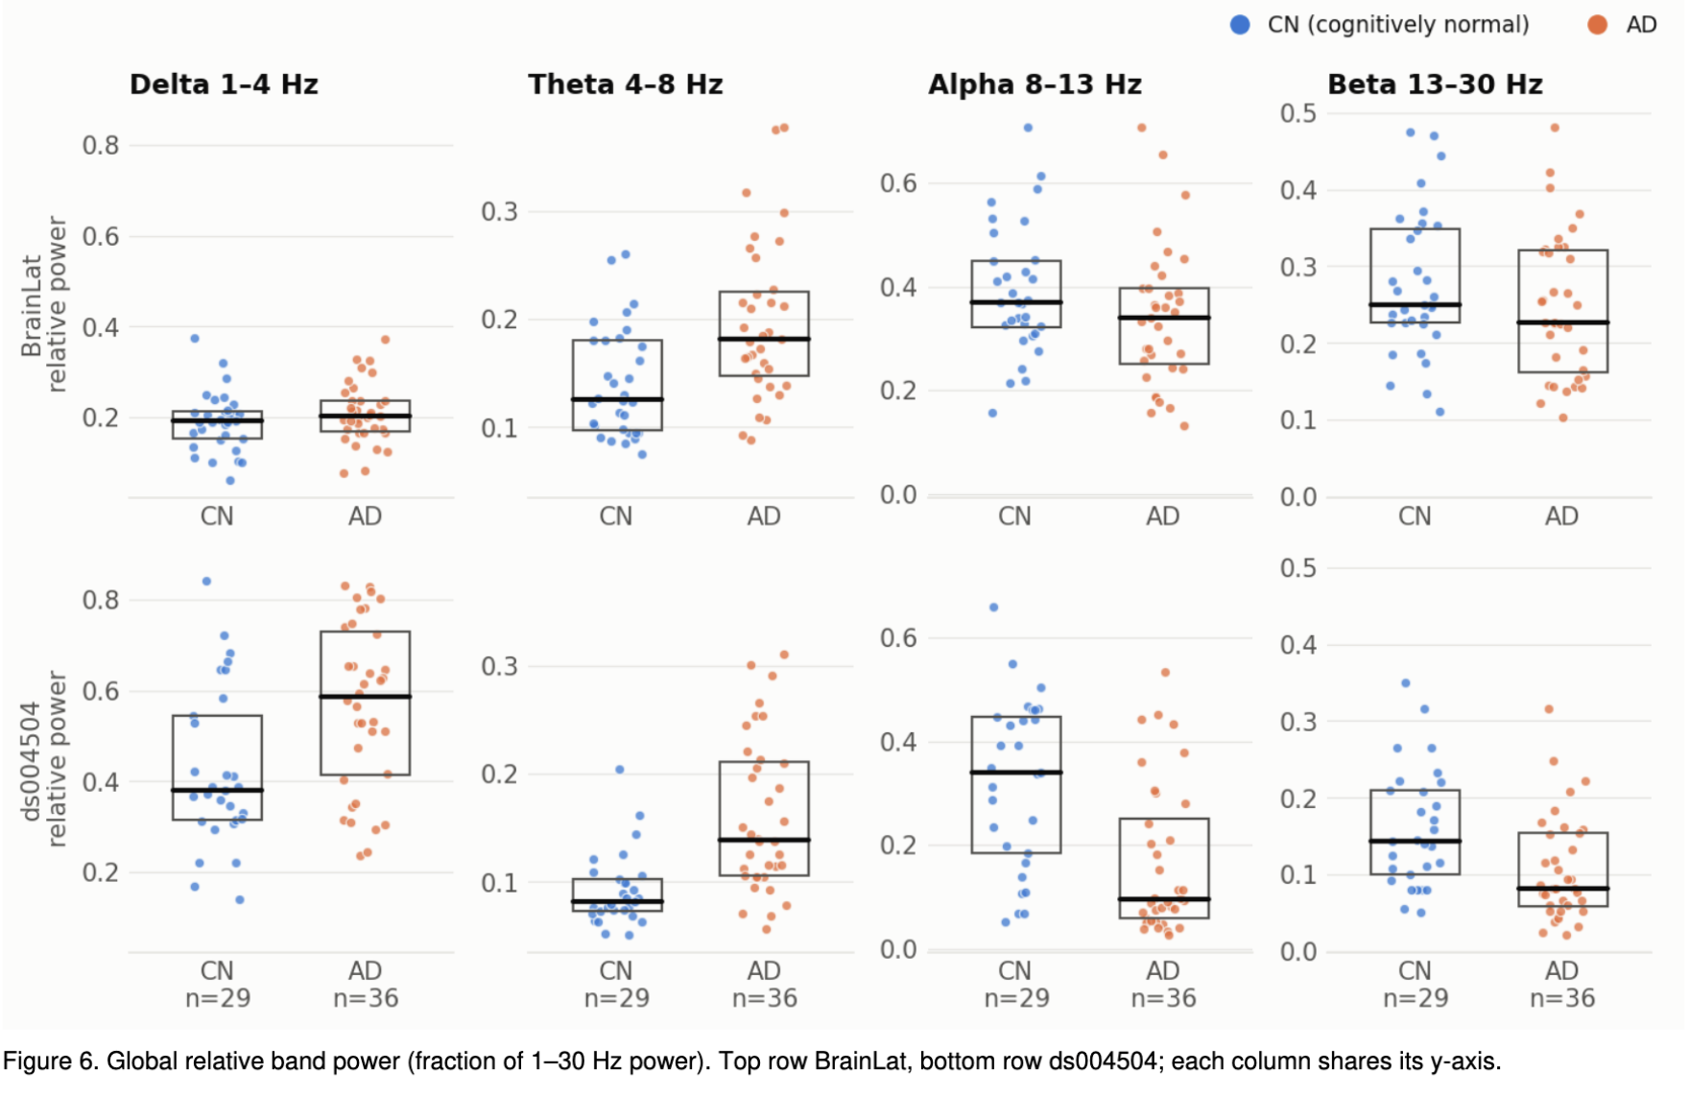
EEG: BrainLat and OpenNeuro
CROSS-AD
Every BrainLat AD file is a rest-plus-heartbeat (rs-HEP) recording, every control a plain rest file, so recording type equals diagnosis.

Slide 8
Features, Models, and Evaluation
CROSS-AD
MRI: 321 Features (Encoder 321 → 64 → 16)
  Regional volume, area, and thickness
  Volumes divided by head size
EEG: 26 Features (Encoder 26 → 32 → 16)
  Same processing for both datasets
  Relative δ θ α β power, θ/α ratio, peak alpha
Shared 16-d space:
One linear AD/CN head for both modalities
A contrastive loss pulls EEG and MRI embeddings with the same label together. Labels only, no subject pairing; each person is predicted from their own modality.
Models | Logistic regression · Simple MLP · joint EEG–MRI model
EEG evaluation | 5-fold CV × 10 repeats, stratified by dataset and diagnosis; train on one EEG dataset, test on the other
MRI evaluation | 5-fold CV × 3 repeats
Fair comparison | AUC; same splits for every model; scaling fit on training folds only

Slide 9
Results: MRI ≈ 0.91 AUC, EEG ≈ 0.73
CROSS-AD
Task (AUC, mean over repeats) | Logistic reg. | Network | Joint EEG+MRI
EEG, both datasets (n = 132) | 0.728 | 0.691 | 0.725
EEG, within ds004504 (65) | 0.798 | 0.774 | 0.804
EEG, within BrainLat (67) | 0.653 | 0.613 | 0.645
EEG, BrainLat → ds004504 | 0.788 | 0.751 | 0.792
EEG, ds004504 → BrainLat | 0.730 | 0.697 | 0.722
MRI, ADNI (n = 870) | 0.869 | 0.912 | 0.913

Slide 10
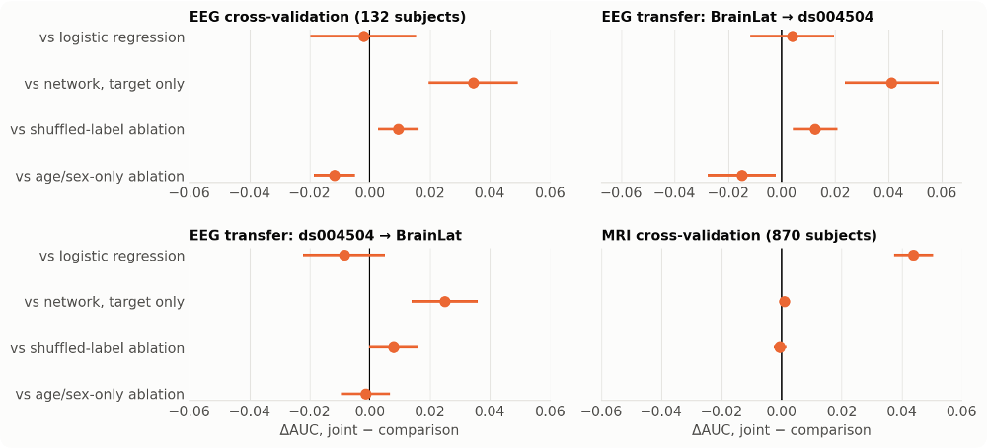
Does Unpaired MRI help EEG?
CROSS-AD
+0.034 vs EEG-only network
+0.009 vs MRI labels shuffled
−0.012 vs age/sex instead of MRI
−0.002 vs logistic regression
The contrastive loss keeps a small network from overfitting; shuffled or age/sex labels do the same job. A controlled negative result, as our proposal anticipated.

Slide 11
Next Steps
CROSS-AD
More complicated model to capture biological explainibility
Nested-CV tuning and feature importance
EEG connectivity and global-only features
Paired EEG, MRI data of same cohort
Test the model on another dataset to check its generality

Slide 12
Thank You!
CROSS-AD

